Slide 1
Introduction to .Net Framework
Venkat Shiva Reddy

Slide 2










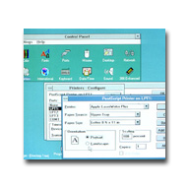

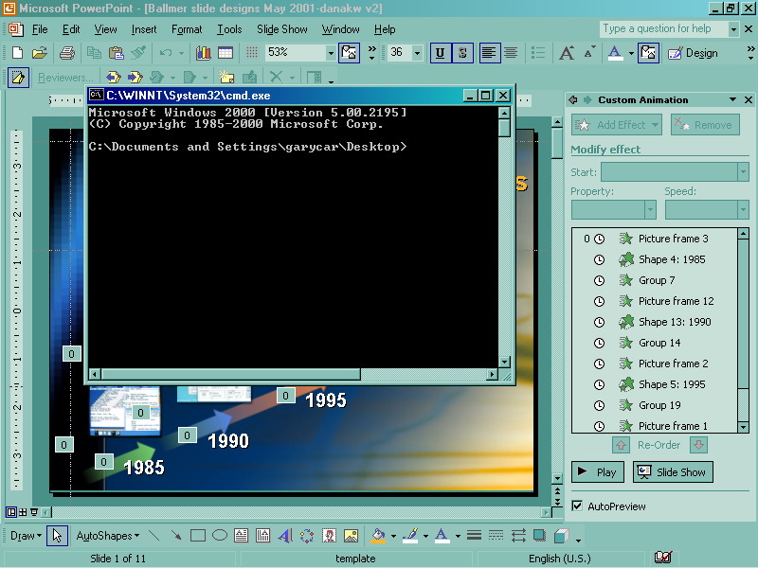


A Rich History
2000
XML Web Services
1995
Internet
1990
GUI
1981
PC
IE, IIS
Visual Studio .NET
Visual Studio
Windows
Visual BASIC
MS-DOS
BASIC
Notes:
Well, every one of these eras had key tools that were used for the applications.
Here you see the evolution that has taken us from text mode apps,
To GUI applications and RAD tools,
And most recently to tools that allow you to build HTML based web applications.
Of course, with my background I would argue that the first tool mentioned under DOS should be Turbo Pascal
And the tool mentioned for GUI should be Delphi
But you get the point.
The next step in this evolution is the .NET Framework and Visual Studio.NET
Three years ago after we shipped VS6, we started to look at where to go next.
We realized we have a great product that allows incredibly powerful solutions to be built.
But we also realized we can do better.
A lot of things are too hard.
We realized we need to do better for distributed apps
The traditional distributed app model using DCOM and just doesn’t scale to the internet
It is too hard to get working on heterogeneous systems
And we relized we have too many different programming models
VB, MFC, ASP
But little or no transferability of skills between those models
We realized our object system is not rich enough
COM doesn’t support fundamental OOP concepts such as classes and inheritance
At the same time it is too complicated
COM is too low-level
No one wants to deal with registry, GUIDs, HRESULTs, AddRef/Release
Versioning and DLL hell is a big problem
Meanwhile, we could see the Internet is growing in leaps and bounds
And we could see that the combination of the net and XML/SOAP was going to be the backbone for distributed apps in the future
But looking at all of these factors, we also realized that we couldn’t get there just by incrementally evolving COM and DNA
We really needed to engineer a whole new platform…

Slide 3
Before .NET
C/Win 32 API
Unsafe (C) and complex (Win32)
C++ and MFC
Better but still difficult
Visual Basic 6.0
Nice, but not completely Object Oriented
COM
Binary Compatibility, good model, still complex
Versioning problems
Java/J2EE
Grate, but not from Microsoft
GUI integration not optimal

Slide 4

Increasing Level of Abstraction
.NET/C# Java
HTML Script
C++ Delphi
Visual Basic
C
Turbo Pascal
MS-BASIC
XML Web Services
The Web
Graphical User Interfaces
ASM
Personal
Computers
2000
Micro Computers
1995
1990
1980

Slide 5


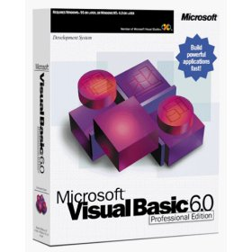
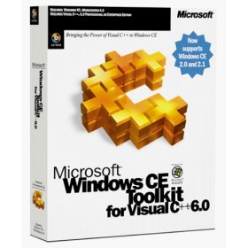

Why .NET?
Low Level
Advance UI
Web
RAD
Advance
Graphics
Devices

Slide 6

Why .NET?
Distinct Programming Models
Learning Curve
Rich Client
Thin Client
Different Job Different Language

Slide 7
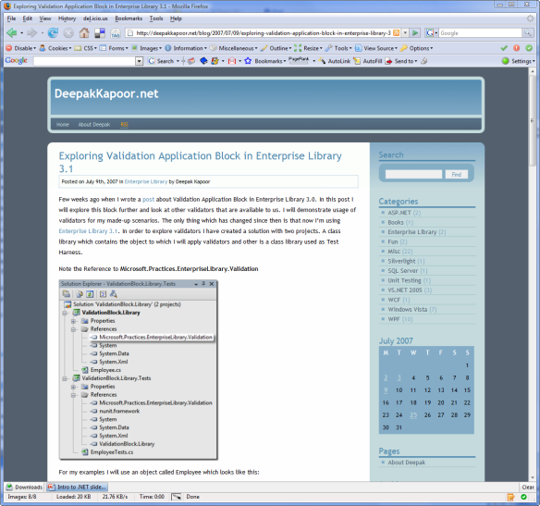
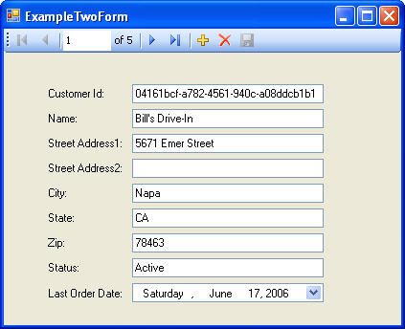

.NET
Consistent Programming Model (BCL)
Web App’s
Desktop App’s
Mobile App’s

Slide 8
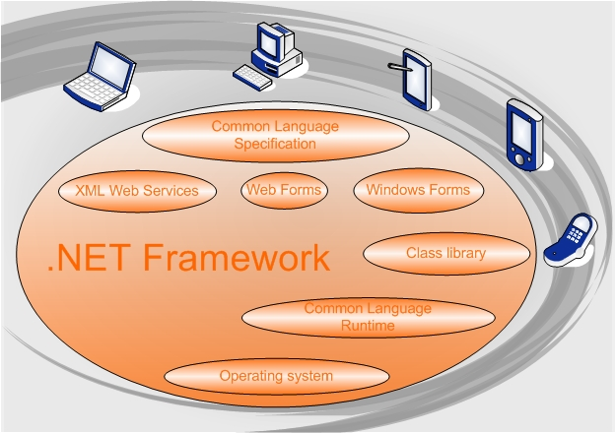
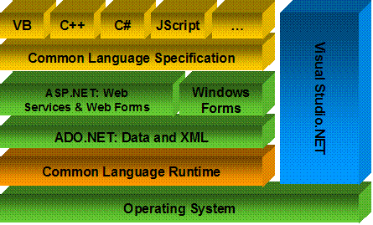
What is .NET ?
.NET is a set of Microsoft software technologies
for connecting information, people, systems, and devices.

Slide 9
What is a Framework?
A Framework is a “defined support structure” in which another software project can be organized and developed.
Typically, a framework may include
support programs,
code libraries
and a language amongst other software to help develop and glue together the different components of your project.

Slide 10
What is .NET Framework?
The .NET framework created by Microsoft is a software development platform focused on rapid application development, platform independence and network transparency.
.NET is Microsoft's strategic initiative for server and desktop development for the next decade.
According to Microsoft, .NET includes many technologies that are designed to facilitate rapid development of Internet and intranet applications.

Slide 11
What is .NET ?
.NET is a set of Microsoft software technologies for connecting information, people, systems, and devices.
.NET Framework is a common layer between .NET applications and Windows OS.
.NET Applications are VB / VC++ / C# programs written on .NET Framework.
. Net Applications
VC++
VB
C#
Other
Other Components
.NET Framework
Class Library
Common Language Runtime (CLR)
Windows Operating System

Slide 12
.Net Framework Design Goals
Simplify development
More power, less plumbing
Unify programming models
Across all languages and application types
Utilize web standards and best practices
Rich XML, standard protocols, stateless
Easier to deploy, run, & maintain
For components, versioning, availability

Slide 13
.NET Framework Components
Common Language Runtime (CLR)
Common type system for all languages
Rich runtime environment
Rich class libraries (.NET Framework)
Base class libraries, ADO.NET and XML
Windows Forms for rich, Win32 applications
Rich, interactive pages
Powerful web services

Slide 14
Framework, Languages, And Tools
VB
C++
C#
JScript
J#
Visual Studio.NET
Common Language Specification
ASP.NET
Web Forms Web Services
Mobile Internet Toolkit
Windows
Forms
ADO.NET and XML
Base Class Library
Common Language Runtime
Operating System

Slide 15
Common Language Runtime (CLR)
VB
C++
C#
JScript
J#
Visual Studio.NET
Common Language Specification
ASP.NET
Web Forms Web Services
Mobile Internet Toolkit
Windows
Forms
ADO.NET and XML
Base Class Library
Common Language Runtime
Operating System

Slide 16
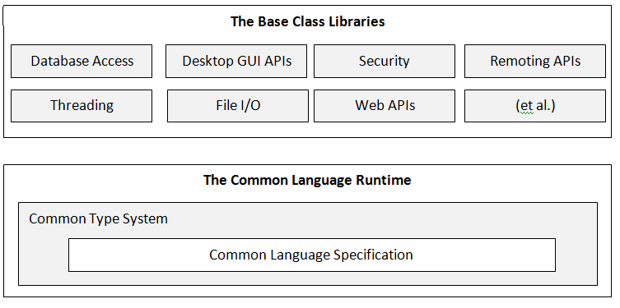
Common Language Runtime - CLR
The Common Language Runtime is the execution engine for .NET Framework applications:
CTS
Common Type System
CLS
Common Language Specification
CIL
Common Intermediate Language
Metadata
VES
Virtual Execution System

Slide 17
Common Language Runtime
Manages running code
Verifies type safety
Provides garbage collection, error handling
Code access security for semi-trusted code
Provides common type system
Value types (integer, float, user defined, etc)
Objects, Interfaces
Provides access to system resources
Native API, COM interop, etc
Notes:
Net classes utilize COM+ services
Transactions, Object pooling, etc…
Native DLLs
Using platform invoke
Runtime marshalling
Controlled through attributes

Slide 18
Base Class Library (BCL)
VB
C++
C#
JScript
J#
Visual Studio.NET
Common Language Specification
ASP.NET
Web Forms Web Services
Mobile Internet Toolkit
Windows
Forms
ADO.NET and XML
Base Class Library
Common Language Runtime
Operating System

Slide 19
.NET Framework Libraries
Single consistent set of object oriented class libraries to enable building distributed applications (Unified Classes)
Built using classes arranged across logical hierarchical namespaces
For example: System.Data.SQL
Work with all CLR languages
No more “VBRun” or “MFC” divide

Slide 20




Unify Programming Models
Consistent API availability regardless of
language and programming model
.NET Framework
RAD,
Composition,
Delegation
Subclassing,
Power,
Expressiveness
Stateless,
Code embedded
in HTML pages
VB Forms
MFC/ATL
ASP
Windows API

Slide 21
How Much Simpler?
Windows API
HWND hwndMain = CreateWindowEx(
0, "MainWClass", "Main Window",
WS_OVERLAPPEDWINDOW | WS_HSCROLL | WS_VSCROLL,
CW_USEDEFAULT, CW_USEDEFAULT,
CW_USEDEFAULT, CW_USEDEFAULT,
(HWND)NULL, (HMENU)NULL, hInstance, NULL);
ShowWindow(hwndMain, SW_SHOWDEFAULT);
UpdateWindow(hwndMain);
.NET Framework
Form form = new Form();
form.Text = "Main Window“;
form.Show();

Slide 22
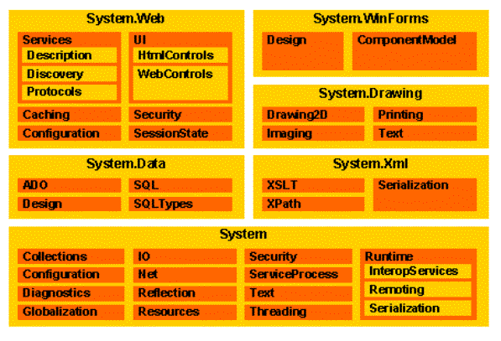
.NET Base Class Libraries

Slide 23
.NET Languages
VB
C++
C#
JScript
J#
Visual Studio.NET
Common Language Specification
ASP.NET
Web Forms Web Services
Mobile Internet Toolkit
Windows
Forms
ADO.NET and XML
Base Class Library
Common Language Runtime
Operating System

Slide 24
.Net Languages
The .NET Platform is language neutral
All .NET languages are first class players
You can leverage your existing skills
Common language specification
Set of features guaranteed to be in all languages

Slide 25
.NET Languages from Microsoft
Microsoft: Visual Basic.NET
Microsoft: C#
Microsoft: C++ (Managed/Unmanaged)
Microsoft: J#

Slide 26
.NET Languages from Others
APL
Fujitsu COBOL
Micro Focus COBOL
Eiffel
Forth
FORTRAN 95
Haskell
Mercury
Mondrian
Oberon
Pascal
Perl
Python
RPG
S#
Scheme
Standard Meta Language

Slide 27

Multilingual Development
Fortran
Perl
Scheme
Smalltalk
Python
Ada
Component Pascal
Oberon
Mercury
Visual Basic
Delphi
C#
Oz
C++
Mondrian
J#
C
Pascal
JScript
APL
Java
Haskell
Eiffel
Cobol
RPG
Objective Caml
ML

Slide 28
The .NET Platform is multi-language
Benefits:
Make code modules reusable
Complete cross-language integration
Make API access the same for all languages
Let developers use the right language for the task and share the code
All .NET languages are first-class players
Performance roughly equal
Can use all .NET features
Notes:
.NET and Languages
In the past, developers had problems sharing code since some worked in Visual C++ and others in Visual Basic. Depending upon how the Visual C++ code is written, it may be reusable for the Visual Basic developers. Microsoft created .NET to alleviate this problem and today, any developer can use a .NET class and event by extending that class for their own purposes. .NET languages build on the common type system of the .NET Framework. Visual Basic .NET and Visual C# provide native access to the .NET type system.
Core concepts:
Everything is an object
Everything implicitly inherits from System.Object
There is a clear distinction between value and reference types
By-Value: Simple Types, Enumerations and Structs
By-Reference: Interfaces, Classes and Arrays
All languages can use .NET features

Slide 29
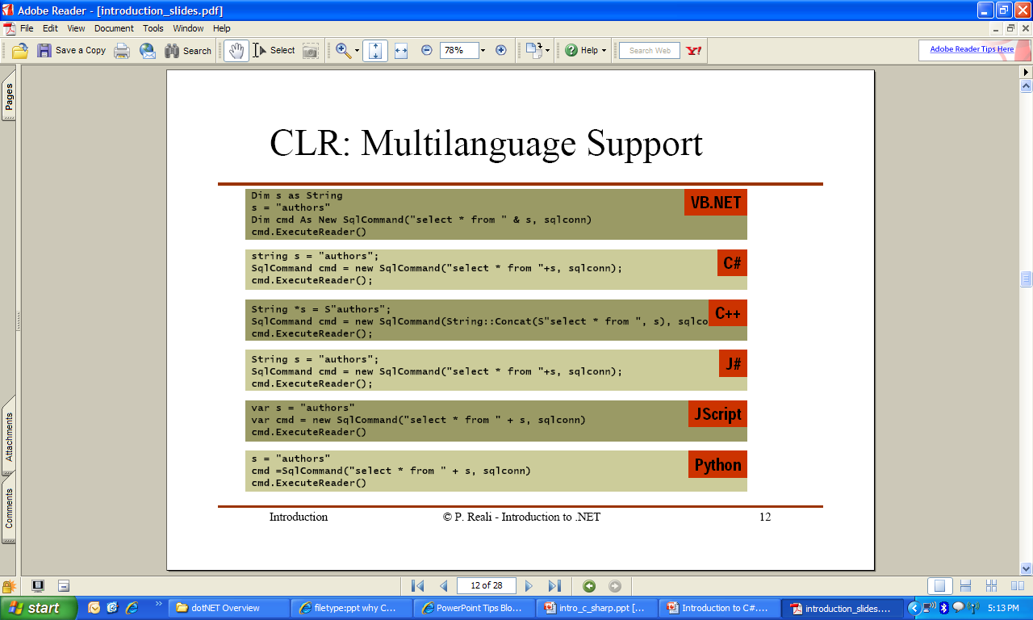
Multi Language Support

Slide 30
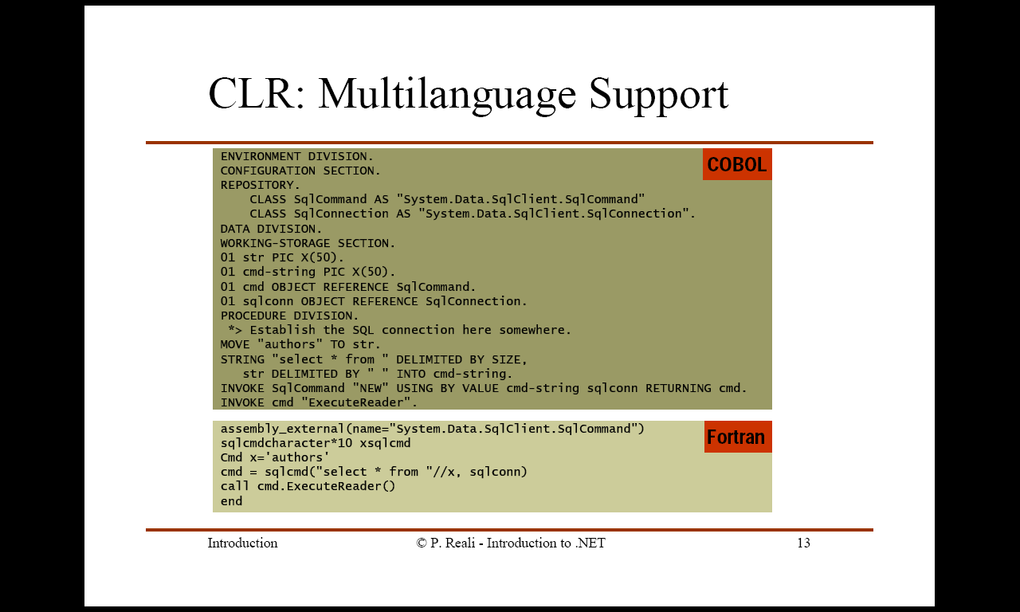
Multi Language Support

Slide 31
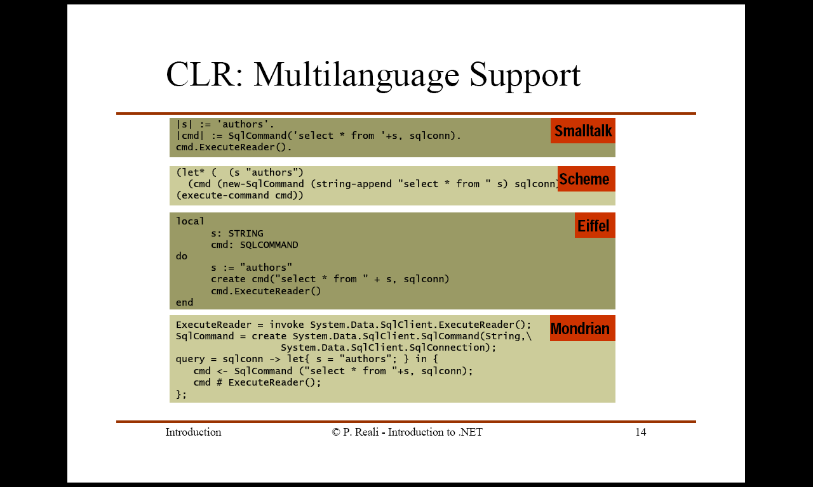
Multi Language Support

Slide 32
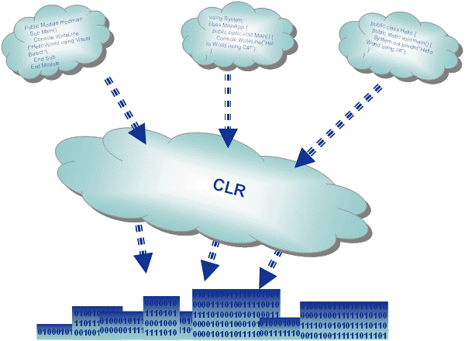
All Languages are compiled to IL code
Notes:
1.Jit compilers for each computer architecture types
2.Metadata is inserted into pe file during compilation
3.econo: generates unoptimized code, code can be discarded and regenerated
4.standard:optimized native code
5.Done at install time reduce start-up time, put the native code in the cache, if in the event the PE file is changed, you should use jit compile
6. To runtime if they failed
7. The native code is in the memory until the process shuts down or garbage collector collect them
Unmanaged code: win32API, com components

Slide 33


.Net Assemblies: Compilation
Assembly
Source Code
Compiler
csc.exe or vbc.exe
C++, C#, VB or any .NET language
DLL or EXE

Slide 34
Compilation And Execution
Compilation
Assembly
Source Code
Language Compiler
Code (IL)
Metadata
Native
Code
JIT Compiler
At installation or the first time each method is called
Execution

Slide 35
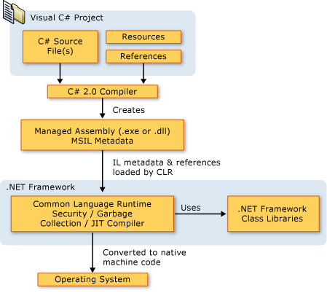
.Net Execution Model

Slide 36
MSIL

Slide 37
Metadata and IL Code
Example: Hello World!
Metadata:
data about data; description of assembly, description of types, attributes
objects can communicate with each other
Stored in binary format, CLR loads metadata into memory for reference
IL code:
intermediate language, CPU independent sets of instructions
Assembly:
a basic unit of versioning, deployment, security management, execute, reuse and sharing.
Manifest: Assembly Metadata
Assembly
C#/VB.Net Sorce Code
Compiler
Metadata
MSIL
Manifest
Notes:
1.Write program using IL
2.Private Assemblies:
Specific to a filesystem directory
Shared (Global) Assemblies: use digital signature to assure assembly identity
Reside in the Global Assembly Cache
Require a “Strong Name”
Name of assembly
Cryptography Key
Culture (language)
4-part version number
Registered using GACUtil.exe
3.Stored in binary format

Slide 38
Visual Studio.NET
VB
C++
C#
JScript
J#
Visual Studio.NET
Common Language Specification
ASP.NET
Web Forms Web Services
Mobile Internet Toolkit
Windows
Forms
ADO.NET and XML
Base Class Library
Common Language Runtime
Operating System

Slide 39
Visual Studio .NET
Comprehensive best-of-breed tool for building connected applications based on .NET for Windows and the Web
All languages under one roof
All application types under one roof
Consistent programming model for all application types
Enterprise Lifecycle Support (VSS, Visio, Enterprise Templates)

Slide 40
Developer Productivity Features
Increased IDE Performance
Startup time reduced
Improved IntelliSense®
Dynamic help faster
Object browser faster
Code editor drop-down menus faster
Enhanced “Add Web Reference” dialog
Code editor enhancements
New components
Debugging enhancements
Designer enhancements
Schema designer zoom
Mobile Web form designer
Integrated community search
Run multiple version of Visual Studio side-by-side:
Visual Studio 6.0
Visual Studio .NET 2002
Visual Studio .NET 2003
Upgrade from Visual Studio .NET 2002 to Visual Studio
Only the project files are updated
Doesn’t change any of your source files
Visual Basic .NET
Fully object-oriented
Free threading, structured exception handling
Host VB6.0 controls in WinForms applications Improved IntelliSense and debugger
Variable declaration in loops
Bitshift operators
Mobile applications
Microsoft® Visual C++® .NET
Managed extensions for C++
ISO C++ conformance
Windows Forms designer
Enhanced floating point performance optimizations
P4 targeting
Microsoft® Visual C# ® .NET
Component-oriented, type-safe
Improved IntelliSense
Custom build steps
Code insertion for common tasks
Mobile applications Microsoft® Visual J#™ .NET
Java-language syntax
Full integration with Visual Studio .NET
Easy way to move Java-language skills,
Full access to the .NET Framework
Notes:
Visual Studio .NET 2003 performs better than Visual Studio .NET 2002.
We mentioned that the .NET Framework is faster. The development environment is faster, too. The startup time of Visual Studio has been reduced by changing the start page to be control-based, rather than browser-based.
The performance of dynamic help has been improved, as has Microsoft® IntelliSense®. The object browser is also faster.
Finally, the drop-down menus for the code editor are faster. This becomes most noticeable when you’re working with a large source file that contains lots of objects and methods.

Slide 41
Visual Studio.NET
Integrated Development Environment
Visual Basic.NET
Many language enhancements
Inheritance,Overloading, Free Threading
Visual C++
Integration with .NET Framework with managed extensions (classes)
C#
New development language
Based on C/C++ with Garbage Collection/Memory Management

Slide 42
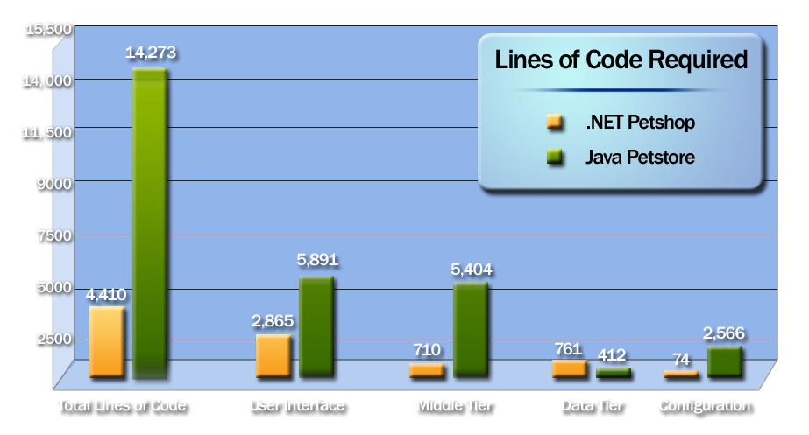
Developer Productivity
Productivity
One third the code
Performance
28 times faster
Scalability
6 times more users
See www.gotdotnet.com
Notes:
KEY MESSAGE: Visual Studio .NET is the Most Productive Tool Ever
SLIDE BUILDS: 0
SLIDE SCRIPT:
There has been much debate over the productivity of developers working on the .NET platform vs. J2EE. We like to let the numbers speak for themselves.
For those who are not familiar, the Java Pet Store demo is a project created in J2EE that illustrates the design guidelines and architectural recommendations for building distributed applications and represents best practices of the Java community. In order to do a true apples-to-apples comparison, we built the .NET Pet Shop project to the same design specifications. As you can see, the results are quite amazing.
We were able to build our version with less than 1/3 of the code. Our version was also able to handle 6 times as many users and run 28 times faster. In fact, we even went a step further and built in support for mobile devices, and even exposed our functionality via XML Web services! As you can see, the power of Visual Studio .NET and the .NET Framework is truly awesome. But don’t take our word for it…
SLIDE TRANSITION: CafePress.com Confirms Developer Productivity

Slide 43
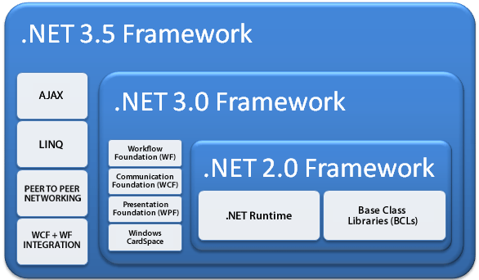
The .NET Framework Stack

Slide 44
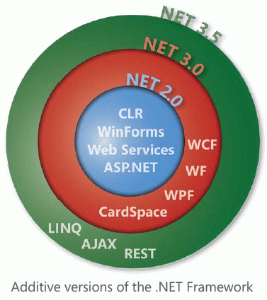
.Net Framework History
.NET Framework 1.0 - January 2002
Initial release
.NET Framework 1.1 - April 2003
Mobile ASP.NET Support
Security Enhancements
ODBC/Oracle Support
.NET Compact Framework
IPv6 Support
Various API Changes
.NET Framework 2.0 - November 2005
Generics!
Hosting API
64-bit Support
ASP.NET enhancements(web controls, personalisation)
Data Controls with Declarative Data Bringing
.NET Micro Framework
Various API Changes
.NET Framework 3.0 - November 2006
Windows Presentation Framework
Windows Communication Framework
Windows Workflow Foundation
Windows CardSpace
.NET Framework 3.5 – November 2007
ASP.NET AJAX
LINQ
Various API Changes
.NET Framework 4.0 – April 2010
MEF, TPL, PLINQ, DLR, MVC, ADO.NET EF

Slide 45
Summary
The .NET Framework
Dramatically simplifies development and deployment
Unifies programming models
Provides robust and secure execution environment
Supports multiple programming languages

Slide 46
Introduction to C#

Slide 47
Need for C#
Existing languages are powerful. Why do we need another language?
Important features are spread out over multiple languages
Example: must choose between pointers (C++) or garbage collection (Java)?
Old languages + new features = poor syntax
Garbage collection in C++?
Event-driven GUIs in Java?

Slide 48
Goals of C#
Give developers a single language with
A full suite of powerful features
A consistent and simple syntax
Increase developer productivity!
Type safety
Garbage collection
Exceptions
Leverage existing skills
Notes:
Dramatically increase productivity
Type safety
Garbage collection
Exceptions
Leverage existing skills
Support component-oriented programming
First class support for component concepts such as properties, events, attributes
Provide unified and extensible type system
Where everything can be treated as an object
Build foundation for future innovation
Concise language specification
Standardization

Slide 49
Goals of C# cont.
Support component-oriented programming
First class support for component concepts such as properties, events, attributes
Provide unified and extensible type system
Where everything can be treated as an object
Build foundation for future innovation
Concise language specification
Standardization

Slide 50

Architectural History of C#
Anders Hejlsberg.
C#'s principal designer and lead architect at Microsoft.
He designed
Visual J++
Borland Delphi
Turbo Pascal
.NET CLR (Core)
C# Language

Slide 51
Design of C#
Derived from the features and syntaxes of other languages
The safety of Java
The ease of Visual Basic
The power of C++
Uses the .NET Framework
Plus several unique features

Slide 52
The safety of Java
100% object oriented
Automatic garbage collection
Array bounds checking at runtime
Strict type checking
Structured exception handling

Slide 53
The ease of Visual Basic
First class support for properties
First class support for events
For-each loops

Slide 54
The power of C++
Enumerations
Operator overloading
Mathematical, Indexing, and Casting
Function pointers
Called “delegates”
Type safe
Structs
Option to pass parameters by reference or by value
Can disable type-safety, garbage collection, and bounds checking
Can directly manipulate memory with pointers (unsafe)

Slide 55
C# Program Structure
Namespaces
Contain types and other namespaces
Type declarations
Classes, structs, interfaces, enums, and delegates
Members
Constants, fields, methods, properties, indexers, events, operators, constructors, destructors
Organization
No header files, code written “in-line”
No declaration order dependence

Slide 56
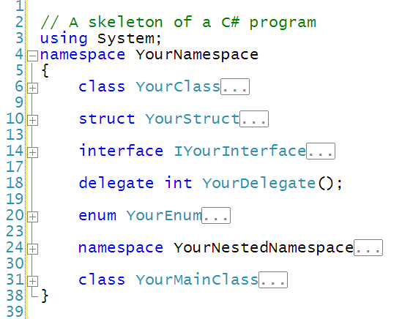
General Structure of C# Program

